Slide 1
CoPE

Slide 2
Freedom of speech over the internet
Reasons against it:
1) People are finding out too much about what is happening in the world.
2) Because people who voice their opinion can do so by insulting a group or person.
3) There is not enough control over the internet.
4)
5)
Reasons for it:
1) Because people can share information on what is happening when their government censors it.
2) People deserve to voice their opinion.
3) You can rarely be persecuted for voicing your opinion.
4)
5)

Slide 3
Case Study
North Korea’s views on the internet:
North Korea are classed as enemy's of the internet; they only allow a few hundred thousand citizens which represents approximately 4% of the population on the internet, which is severely governed.
Most citizens have access to the governments intranet server, which is called Kwangmyong, this has only a few selected websites controlled by the government; these websites are full of propaganda.

Slide 4
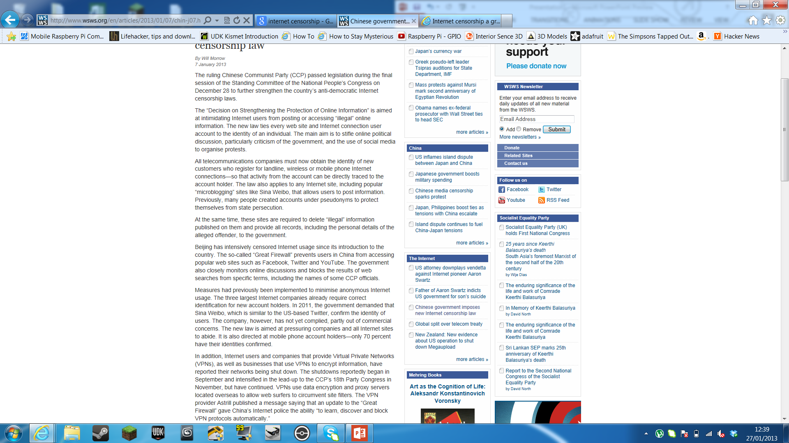
Annotated Article 1
In this article, the Chinese government are enforcing new rules tying every device and username to a specific person so any activity can be traced back to that person.
They are also blocking many VPN companies which provide an encrypted and safer mean of traveling through the internet as they make it harder for the Chinese government to trace what is seen and posted to a specific person.
http://www.wsws.org/en/articles/2013/01/07/chin-j07.html
I believe this is wrong as it stops any anomonity over the internet and is destroying businesses who deal with VNPs.

Slide 5
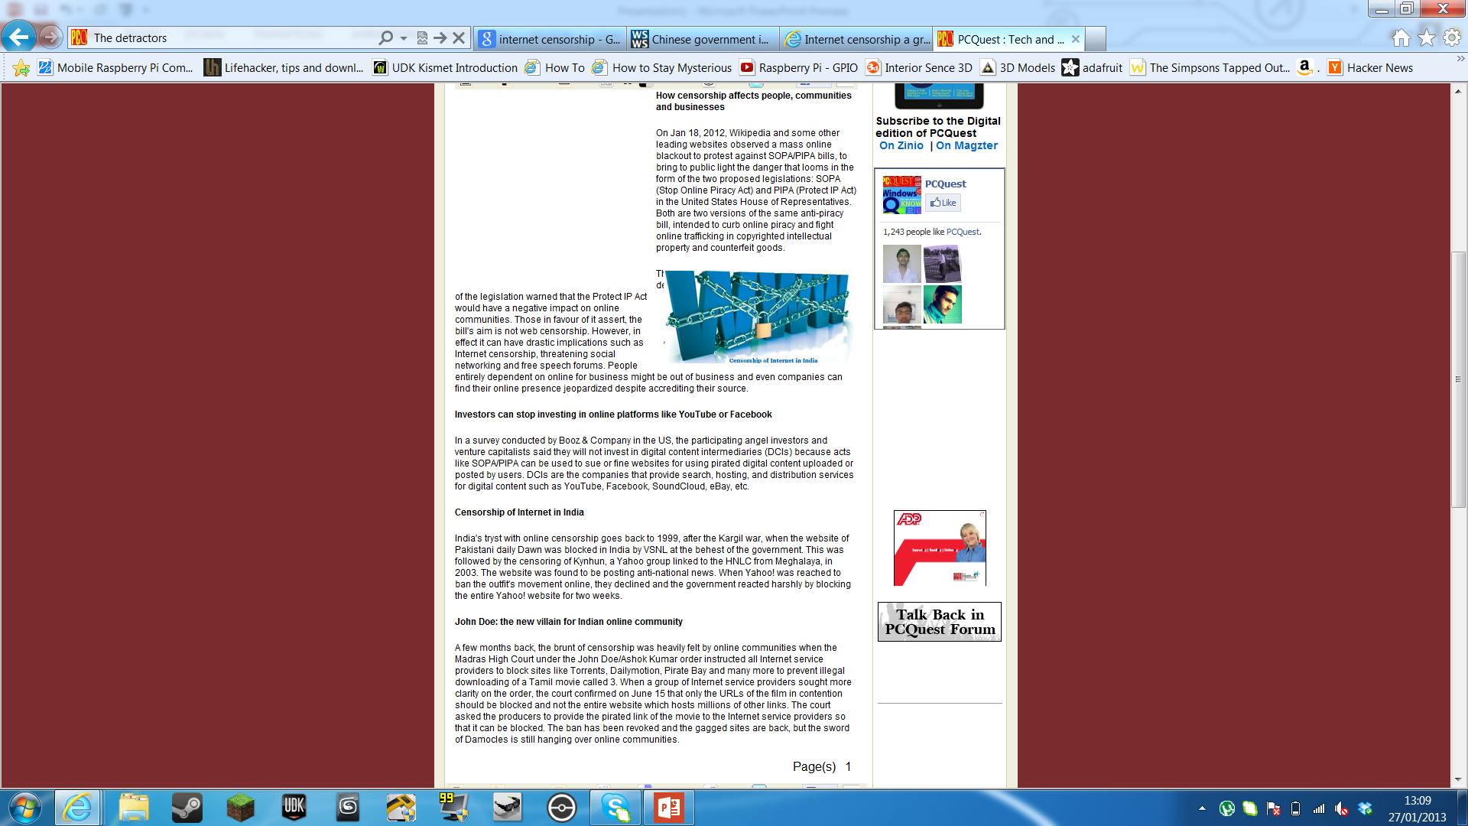
Annotate Article 2
This article shows us how censorship could affect people and businesses.
It does this by explaining how SOPA and PIPA could stop investors and share holders could stop investing in websites, thus leading to the websites being shut down do to lack of funding.
http://pcquest.ciol.com/content/techtrends/2012/112123102.asp

Slide 6
Findings in my Questionnaire
Through the findings of my questionnaire I have found:
People believe we need freedom of speech over the internet.
People do not have enough freedom of speech over the internet.
It is undecided if there is too much control over the internet.
People believe we do not need any more limitations over the internet.
People do not know what they can and can’t say over the internet.

